Slide 1
<Project title>
<Your Name>, CPSC 541, PRP I

Slide 2
DATA DESCRIPTION & Experimental Design
CPSC 541
<Describe the design>
# of entries
# of treatments
Hypothesis being tested
Include a Graphic Representation of Your experimental Set up

Slide 3
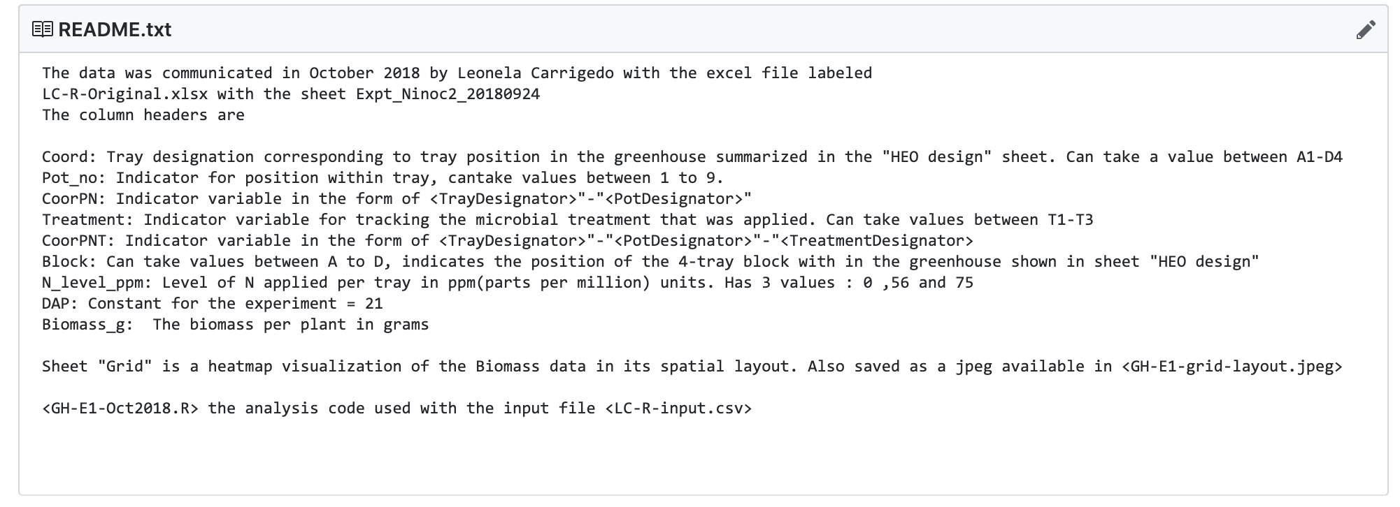
Data Description
CPSC 541

Slide 4
AnAlytical APPROACH
CPSC 541
Model proposal
Model test
<code goes here>

Slide 5
RESULTS

